Slide 1
Adjuvants for Rosarians
Increasing Spray Effectiveness

Slide 2
What is an Adjuvant?
The definition of adjuvant is: a person or thing that aids or helps
In the context of pesticides, an adjuvant helps them do their job of attacking and killing pests
Most adjuvants available to rosarians are liquids added to the pesticide spray solution when mixing

Slide 3
Why Use an Adjuvant?
Researchers claim that up to 70% of the effect of a pesticide is dependent on its application
In other words, regardless of the claims made for a particular pesticide, its effectiveness is no better than the way it’s applied
Adjuvants serve to enhance the quality of a pesticide’s application

Slide 4
Types of Adjuvants
Surfactant – a “spreader-sticker” such as manufactured by Hi-Yield
Buffer – adjusts the pH of the spray liquid – for example, Indicate 5 by Brandt
Extender – binds contact pesticides to foliage – provides protection for pesticide from rain and UV rays
Penetrant – opens leaf’s stomata to promote entry of systemic/translaminar pesticides and liquid fertilizers
Attractants – draws insect pests to pesticide – for example, spider mites to Stirrup M by Troy Biosciences

Slide 5
Extenders – an example
Binde manufactured by AgXplore International
An extender/sticker/spreader designed specifically to extend the life of pesticides
Non-ionic and may be used with all pesticide products
Forms a durable film that holds pesticide on foliage after spraying
Shields contact sprays from dilution by rain and degradation by UV rays
Available from Keystone Pest Solutions (www.keystonepestsolutions.com) for $38.95/gallon
Use rate: ½ to 1 teaspoon per gallon of spray

Slide 6
Penetrants – an example
Cadence – manufactured by Kalo, Inc.
An organo-silicone-based non-ionic wetter/spreader/penetrant
Formulated to greatly reduce the surface tension of the spray droplets
The very low surface tension, in turn, results in stomatal flooding thereby significantly enhancing the uptake of systemic and translaminar pesticides
Available directly from Kalo (www.kalo.com) for about $55/gallon
Use rate: ½ teaspoon per gallon of spray

Slide 7
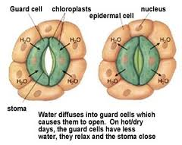
Plant Stoma

Slide 8
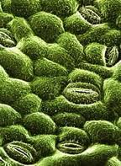
Stomata Close-Up

Slide 9
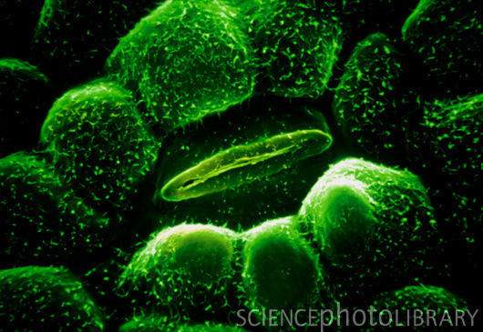
Stoma Even Closer

Slide 10
My experience
I’ve been using Cadence and Binde for about three months
I use Cadence with systemics such as Phyton 27, Banner Maxx, Cleary’s 3336F and with translaminars such as Compass
I also use Cadence with liquid fertilizers such as EZ-Feed and Miracle-Gro Rose Food for foliar feeding
Blackspot has been held in check and drench feeding has not been used for three months
Bushes appear quite healthy with only foliar feeding – which greatly reduces the fertilizer use rate and concerns about soil pH
I use Binde with contact pesticides such as Pentathlon – leaves foliage quite “spotted” but pesticide remains for many weeks

Slide 11
A Few Words About Indicate 5
Indicate 5 is a spreader-sticker and a buffer
It serves to acidify the spray liquid if the water source is “hard” – that is with a pH greater than 7
Following label directions it lowers the spray’s pH to below 5
In my experience acidifying the spray liquid appears to have a deleterious effect on metallic-based pesticides such as Phyton 27 (copper) and Pentathlon (manganese)
I suggest using a simple spreader-sticker or Cadence for Phyton 27 and Binde for Pentathlon

